Slide 1
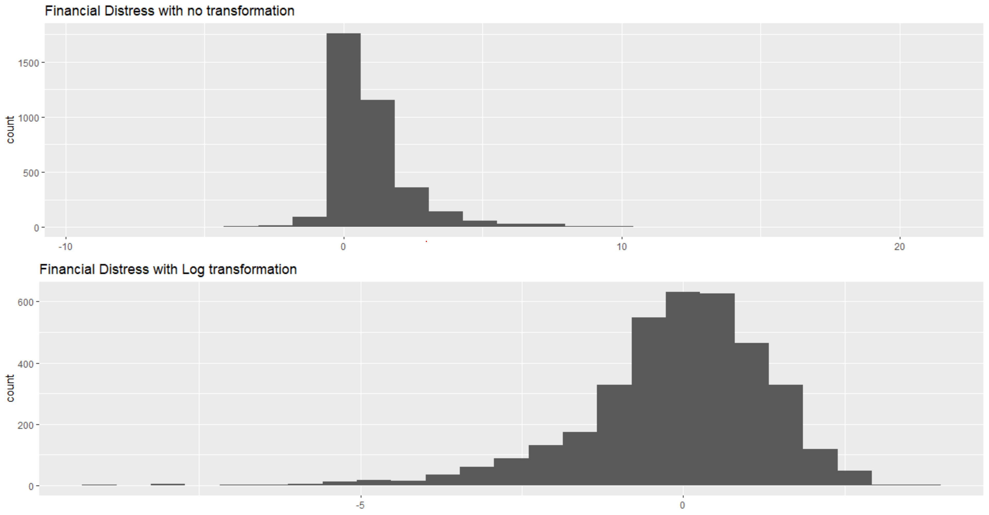
Understanding the data
The financial distress is our y-variable that we will try to predict.
It is mostly between -2 to +2 and is given right skewed.
We try to transform he variable by taking a log transformation of our response variable.
Total features are 66, and total observations are 3671.
The log transformation equation:
y = log(y + 1 – min(y))
6. To further normalize it make it more close to the standard normal curve we can also do:
y = log(square-root(y^2)) + c

Slide 2
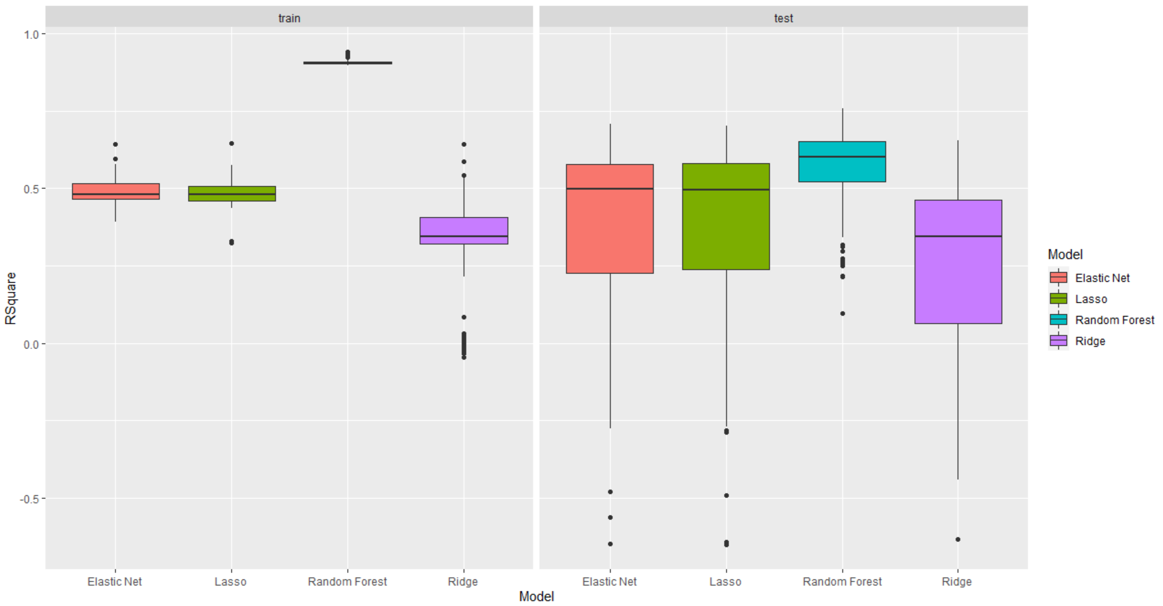
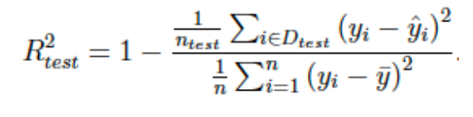
Box Plots of R-Square Value for all 4 models
The data was split into training and test data set. Training set is 80% of all the observations and test set is the remaining 20%
Run a simulation of 100 samples
We fit the data for 4 regression models – Elastic Net, Lasso, Random Forest and Ridge.
We use the following equation to calculate our R-square value:
Model | R-Square (median)
 | Train | Test
Elastic Net | 0.46 | 0.48
Lasso | 0.44 | 0.48
Random Forest | 0.9 | 0.63
Ridge | 0.38 | 0.36

Slide 3
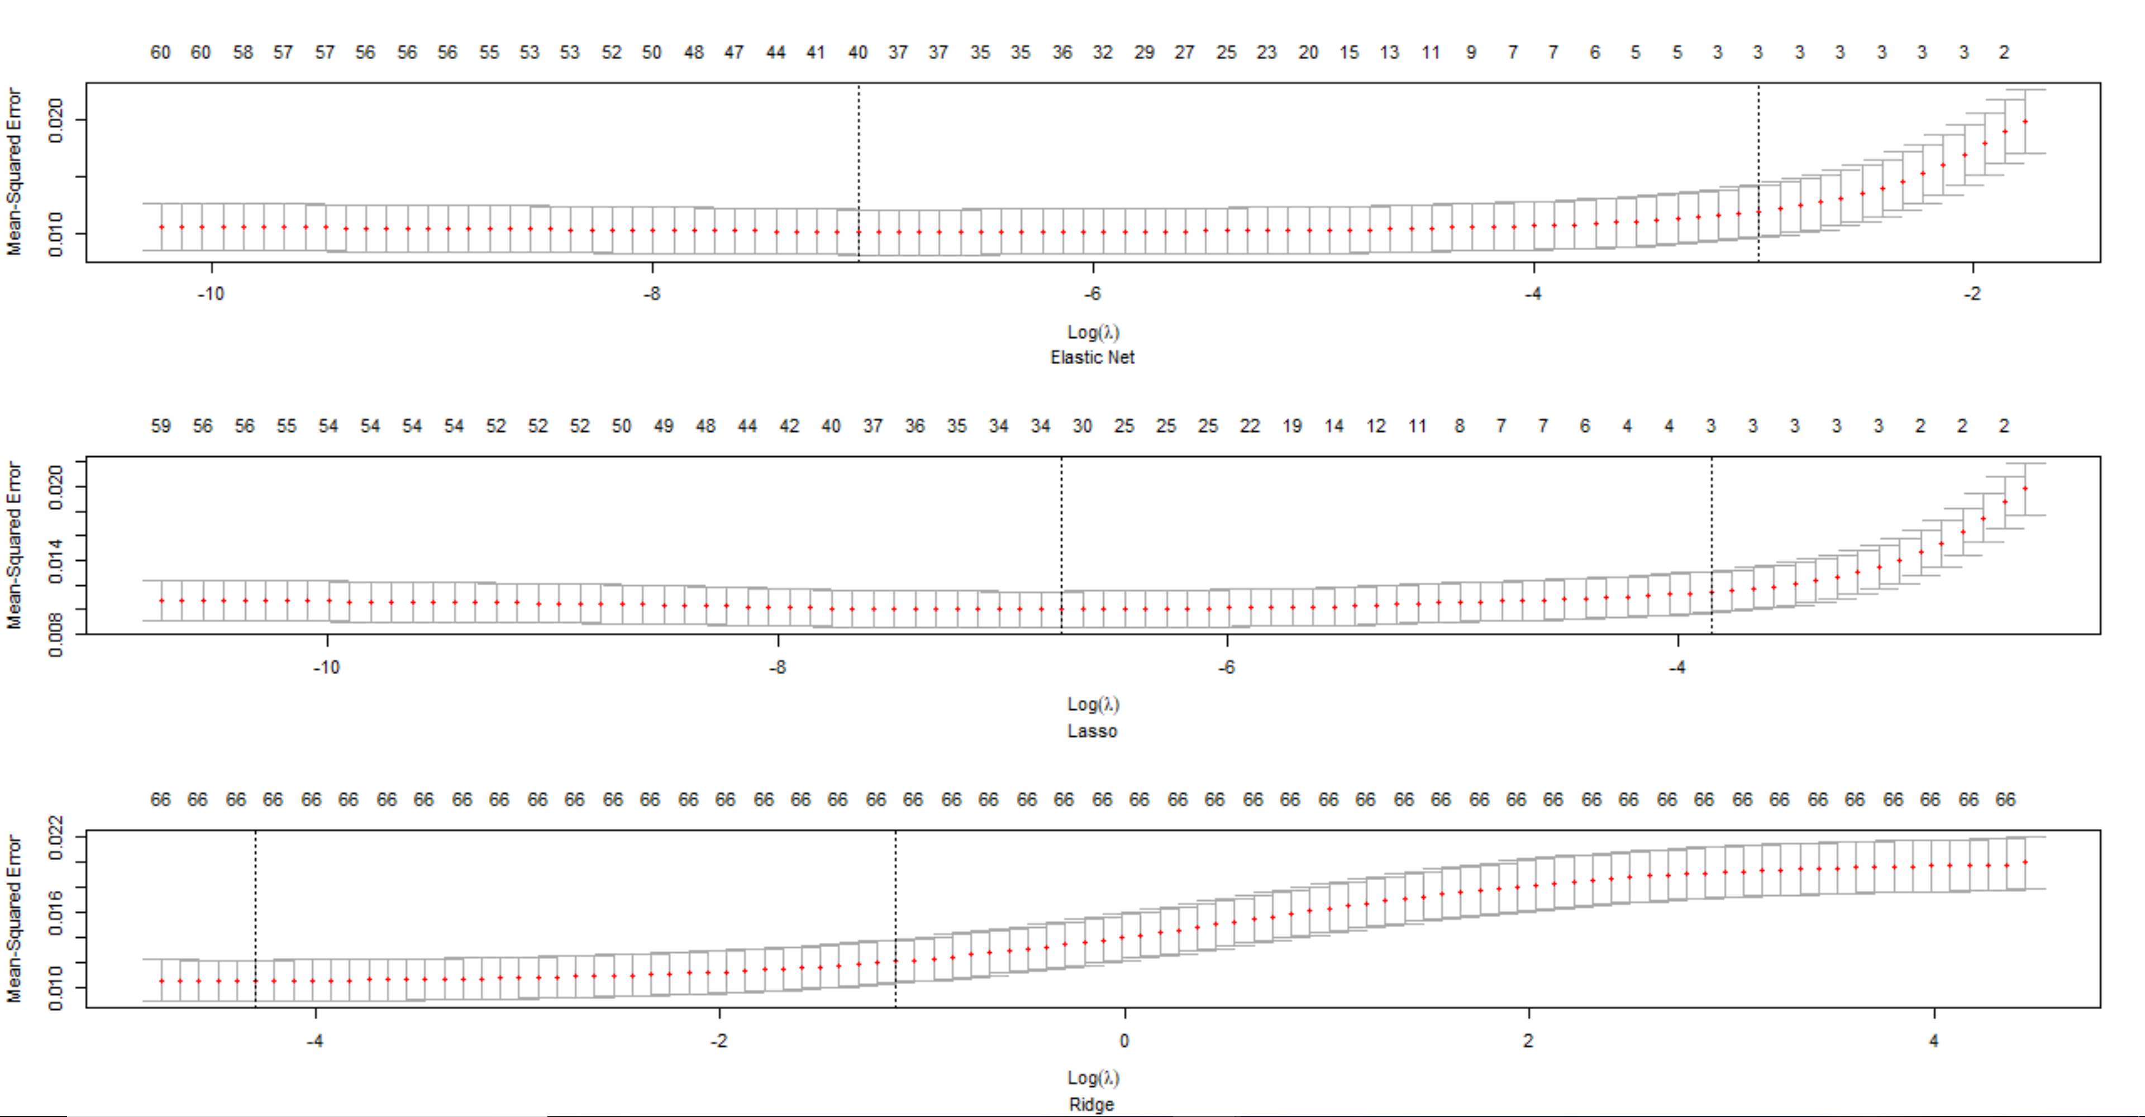
10-fold CV curves for Elastic Net, Lasso, Ridge
We use 10-fold cross validation to tune in all the lambdas.
Elastic Net uses 40 features, Lasso uses 32 features whereas Ridge uses all 66 features.
Model | Minimum lambda
Elastic Net | 0.0006014624
Lasso | 0.0006947281
Ridge | 0.05255364

Slide 4
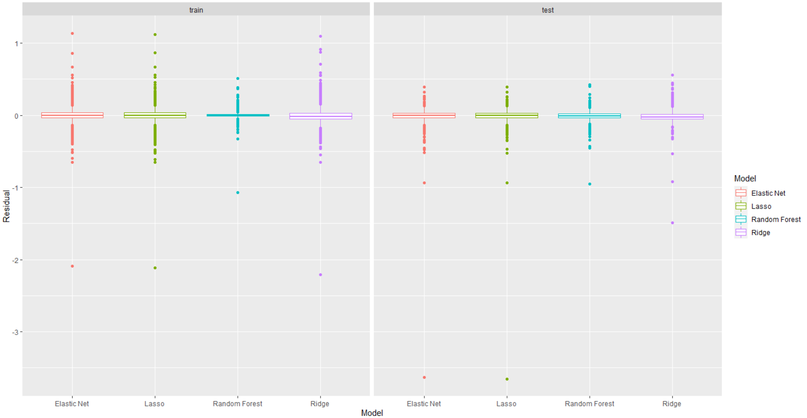
Box Plots of Residuals for all 4 models
Residual plot has similar results for all the 4 models and the median is close to 0.
The observations are not much different between train and test set.
Random Forest has more compact results with the smallest interquartile range. This can also be attributed to the fact that Random Forest is probably overfitting the variables. That means the model has extra capacity to pick the random noise in the observation.

Slide 5
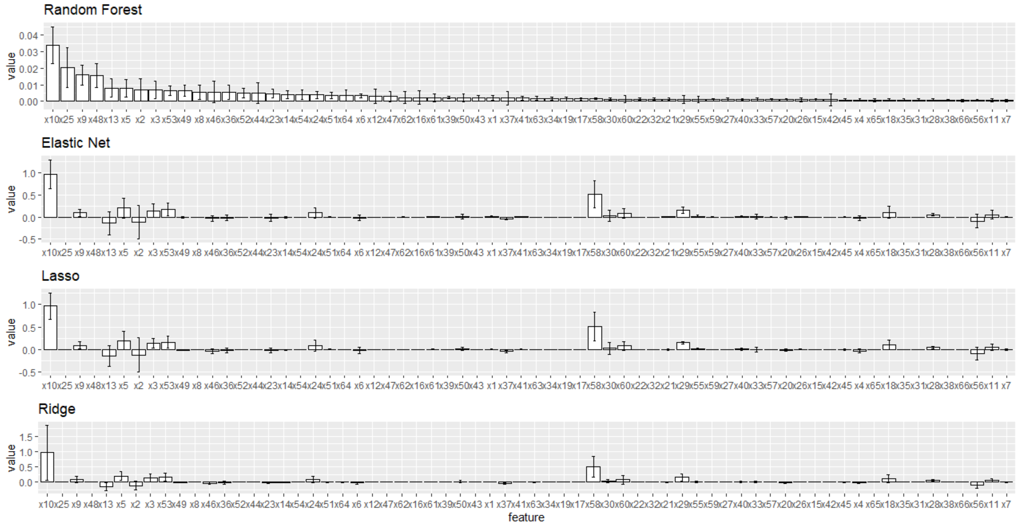
Bar plots with bootstrapped error bars
Ran a simulation of 100 for bootstrap exercise.
Arranged all the bar plots with errors in descending order of output from random forest.
Variable X10 appears to be a prominent feature for all the models which is equity/total assets.
Also, in general, the observation says, any feature that talks about total expense divided by overall asset value helps in deciding the financial distress.
The results from Elastic Net, Ridge and Lasso are similar.

Slide 6
Summary
In the preceding slides, we saw that from R-square box-plot Radom Forest seems to be the best model for prediction.
Lasso and Elastic – Net almost show same results without much to differentiate.
Ridge seems to have the maximum variance with quite a few negative R-square and thus is not a great model for predicting financial distress.
The residual box plot kind of showed similar results for all the 4 models with median around 0 but the quartile range was lowest for random forest.
The residual plots for test show lesser variance and thus are a good reflection of our prediction.
More outliers are seen towards positive side of 0 than the negative side of 0, which means the model is more biased with positive values in the dataset.
Through bootstrap bar plot, we can see that Random Forest is best at picking the important features that will help us predict the financial distress.
It has more non – zero coefficients and is best at picking the important features. In this case X variables – 10, 25 and 9 are the best predictors. Those features basically are:
x10 – equity/total assets, x25 - (equity - share capital) / total assets and x9 - sales / total assets.
For Elastic Net, Ridge and Lasso, again X10 seems to be the most important features whereas they also identify X58 - total costs /total sales as an important feature for prediction.
Lastly, looking at the time required for tuning each model, we see that Random Forest takes a lot more time in analyzing the features than other models for prediction. The break down of time is shared on the right-hand side.
Model | Time (in secs)
Elastic Net | 0.24
Lasso | 0.28
Random Forest | 27.46
Ridge | 0.27

